Slide 2
INVESTOR INSIGHTS

Slide 3
THE CHOICE YOU HAVE MADE TODAY

Slide 4
The Mandatory Disclaimer
This presentation contains highly graphical content !
It will gyrate between the highly boring to the hard-to-believe you may hear for the very first time
Much of the presented research has been done by professionals. For mastering these and incorporating them into your practice, please try these stunts at your workplace!
Viewer discretion is not advised. Please note down stuff you didn’t know about! Don’t let the notepads on your table end up with hawkers!
Running Time: 20 mins

Slide 5
COMMON ADVISOR INSIGHTS ON INVESTORS…
“HNIs are a relatively satisfied lot. They want moderate returns & they are relatively patient!”
“Middle class investors are generally aggressive. They look at returns very frequently”
“My clients want high returns but with no risk”
“Investors don’t compare apples to apples!”

Slide 6
WELL, WE ALL HAVE INVESTOR INSIGHTS…

Slide 7
…MANY OF OUR INSIGHTS ARE LIKE A POST-MORTEM

Slide 8
IN THE REMAINING TIME...
Lesser known Investor Insights
Some proposals and solutions
Special Feature: Consciously influence the Sub-Conscious!

Slide 9
NAÏVE STRATEGIES / POPULAR MODELS
Extrapolating past earnings too far into the future
Assuming a trend in stock prices
Over-reacting to good and bad news
Simply equating a well-run company with a good investment, irrespective of price

Slide 10
MYTHS ABOUT RISK !
Risk Profiling
Risk Tolerance

Slide 11
OLD HABITS DIE HARD !

Slide 12
ONE BRAIN…TWO PARTS !
Analyzer !
Decider !

Slide 13
MEMORY MANAGEMENT !
Emotions & Imagination
E x p e r I e n c e

Slide 14
BIAS IS THE BASIS !

Slide 15
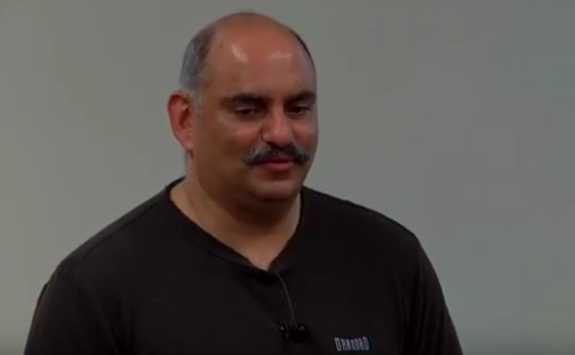
TWO PEOPLE WHO CAN HELP YOU FIRST !

Slide 16
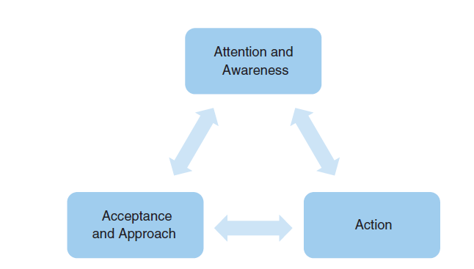
GET AWARE & TAKE CHARGE !

Slide 17
SUBCONSICOUS MINDS ARE CONSCIOUS! (READY FOR YOUR MEETING?)
Impact of visuals & colours
Priming
BEFORE
DURING
‘Quality Time’
Meeting ‘Setup’
‘Audio Video’ ‘Setup’
‘Repeat Mode’
Genuine Gifting
AFTER

Slide 18
PERFECT PARTNERS!
‘Gamechanger Tools’ for distributors / advisors
Movie properties
Visually oriented online experiences
Learning from Behavioural Finance

Slide 19
READ THIS OUT ALOUD !

